Slide 1



Using novel remote electronic monitoring to measure and manage the Rheumatology Clinic backlog generated by COVID-19
Dr. Dominik Kurzeja
BA, BM BCh
dominik.kurzeja@doctors.org.uk
@domashwin

Slide 2




Using novel remote electronic monitoring to measure and manage the
Rheumatology Clinic backlog generated by COVID-19
.
Dominik Kurzeja¹, Anushka Soni², John Jackman², Joel David², Raashid Luqmani²
¹Internal Medicine, Oxford University Hospitals, Oxford, UNITED KINGDOM, ²Rheumatology, Nuffield Orthopaedic Centre, Oxford, UNITED KINGDOM
BACKGROUND
During the COVID-19 pandemic we were unable to provide regular outpatient services.
A backlog of 6812 patients without an allocated follow-up appointment accrued by September 2021.
We aimed to analysed attempts to deliver care remotely to patients on the backlog using:
Video appointments
Telephone Appointments
Electronic remote management forms (RMFs).
METHODOLOGY
We focussed on patients whose last appointment was between May 2020-May 2021 This was initially 3259 patients out of the total backlog of 6812.
We studied the this on four occasions between September ‘21 and September ‘22: at baseline, then at 1, 2, 6 and 12-months
Sep 2021
Oct 2021
Nov 2021
Mar 2022
Sep 2022
1
2
3
4
5
Audit Time Points

Slide 3
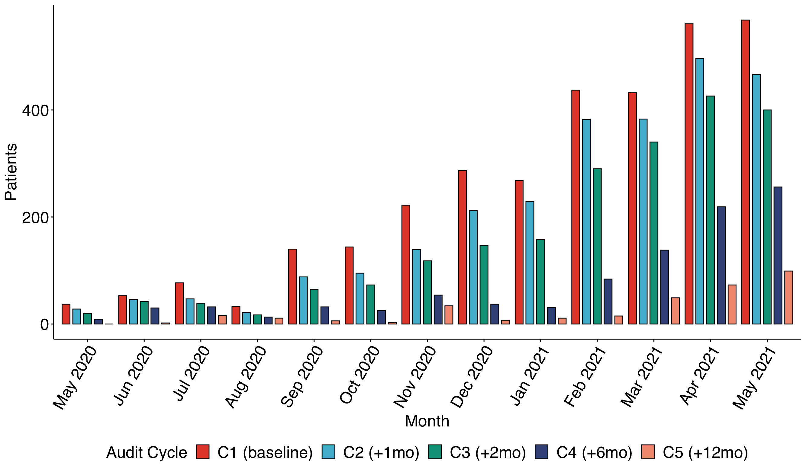
Using novel remote electronic monitoring to measure and manage the
Rheumatology Clinic backlog generated by COVID-19
.
Dominik Kurzeja¹, Anushka Soni², John Jackman², Joel David², Raashid Luqmani²
¹Internal Medicine, Oxford University Hospitals, Oxford, UNITED KINGDOM, ²Rheumatology, Nuffield Orthopaedic Centre, Oxford, UNITED KINGDOM
RESULTS
Remote Management Forms
1956 were completed between Sep-21 - Mar-22 (no data available since then)
Only 261 patients recorded prior appointment date.
154/261 (59%) were completed by patients on the backlog between May-20 - May-21, indicating a preferential use of RMFs targeting backlog patients.
5% of all backlog patients were managed with RMFs (based on available data).
Months from Baseline | Cumulative pts seen (%) | Cumulative assessed by RMF (%)
+1 | 626 (19) | 17 (2.72)
+2 | 1124 (34) | 60 (5.3)
+6 | 2299 (71) | 154 (6.7)
+12 | 2933 (90) | 154 (5.2)
We demonstrate a 90% reduction in patients awaiting follow-up from 3259 to 326 over 12 months. 71% reduction achieved by 6 months.
This reduction was statistically significant and progressive (p<0.001 - Chi-square test for trend).

Slide 4

Using novel remote electronic monitoring to measure and manage the
Rheumatology Clinic backlog generated by COVID-19
.
Dominik Kurzeja¹, Anushka Soni², John Jackman², Joel David², Raashid Luqmani²
¹Internal Medicine, Oxford University Hospitals, Oxford, UNITED KINGDOM, ²Rheumatology, Nuffield Orthopaedic Centre, Oxford, UNITED KINGDOM
CONCLUSION
We have significantly reduced the size of our backlog of outpatient follow-up due to COVID-19 over a 12-month period with a sizable contribution from remote management.
1
2
3
We demonstrate a 90% reduction in the number of patients with unallocated follow up since the pandemic period within 12 months
Remote management made a sizeable contribution, meaning some of this reduction was achieved without clinician-patient encounters; these results underestimate the effect of RMFs due to this dataset being incomplete
We show robust integration of our RMFs into outpatient services, providing evidence for remote management as a useful tool in outpatient care e.g. in areas such as patient-initiated follow-up pathways.
References:
Annals of the Rheumatic Diseases 2021;80:289-290.

Slide 5

Intro + Title
Using novel remote electronic monitoring to measure and manage the Rheumatology Clinic backlog generated by COVID-19
Dominik Kurzeja1, Anushka Soni2, John Jackman2, Joel David2, Raashid Luqmani2, 1Internal Medicine, Oxford University Hospitals, Oxford, UNITED KINGDOM, 2Rheumatology, Nuffield Orthopaedic Centre, Oxford, UNITED KINGDOM
Background & Aims
During the COVID-19 pandemic we were unable to provide regular outpatient services for patients with chronic rheumatic diseases. A backlog of 6812 patients without an allocated follow-up appointment accrued by September 2021.
We quantified this cohort and analysed attempts to deliver care remotely using:
Video
Telephone
Electronic remote management forms (RMFs).
Dr. Dominik Kurzeja
BA, BM BCh
dominik.kurzeja@doctors.org.uk
@domashwin

Slide 6
Methods
Methods
We selected a 12-month window from May 2020-May 2021 and analysed the number of patients awaiting follow-up during this period. This was initially 3259 patients out of the total backlog of 6812.
We revisited the number of patients remaining in that cohort on four occasions between September 2021 and September 2022: at baseline, then at 1-, 2-, 6- and 12-month intervals (Fig. 1)
Alongside usual follow-up pathways, (face to face, video or telephone), we implemented remote management forms (RMFs) for different disease groups which were designed by the department; they contained a triage questionnaire, including calculation of disease severity scores, and questions about medications. These were sent out by clinicians to some patients in lieu of telephone, video or face to face appointments¹
Data from RMFs was stored in a secure database for clinician review.
Data analysis performed in Microsoft Excel and R (version 4.2.1).

Slide 7
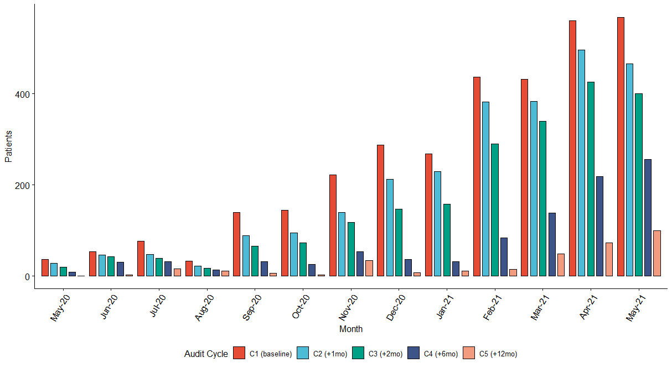

FIGURES + results
Patients with last consultation between May 2020 and May 2021
Sep 2021
Oct 2021
Nov 2021
Mar 2022
Sep 2022
C1
C2
C3
C4
C5
Audit Time Points
Figure 1. Schematic diagram of the timeline of this project
Results - For full analysis scan the QR code
We demonstrate a 90% reduction in patients awaiting follow-up 3259 to 326 over 12 months. 71% reduction achieved by 6 months (Fig. 2)
This reduction was statistically significant and progressive (p<0.001 - Chi-square test for trend).
Remote Management Forms
1956 RMFs were completed between Sep-21 - Mar-22 (no data available since then)
Only 261 patients recorded a previous appointment date.
154/261 (59%) were completed by patients in the “window” of May-20 - May-21, indicating a preferential use of RMFs targeting backlog patients.
Between 2-8% of the total backlog patients were managed using RMFs based on available data (Table. 1.).
Figure 2. Number of patients remaining on the backlog in each month of May 2020 - May 2021 reduced over time
Audit Cycle | Backlog Total | Patients shifted | No. RMFs complete (%)
1 | 3259 | NA | NA
2 | 2633 | 626 | 17 (2.72)
2 | 2135 | 498 | 43 (8.63)
4 | 960 | 1175 | 94 (8.00)
Table 1 Proportion of patients for whom RMFs were used in lieu of other consultation type (data is incomplete)

Slide 8
Conclusions
We have significantly reduced the size of our backlog of outpatient follow-up due to COVID-19 over a 12-month period with a sizable contribution from remote management
Our outpatient backlog has been significantly reduced over a 12-month period.
Remote management made a sizeable contribution to this reduction, meaning some of this reduction was achieved without face-to-face encounters; these results underestimate the effect of RMFs due to this dataset being incomplete
1956 RMFs completed in a 6-month period shows robust integration of our RMFs into outpatient services disrupted by COVID-19 and provides evidence for remote management as a useful tool in outpatient management, with relevance to areas such as Patient Initiated follow-up pathways.
Further work is needed to clarify where remote management is best deployed and which patient groups benefit most from this.

Slide 9
RGB colour: #3682A9
References
Malley T, Jackman J, Manderson S, et al. Annals of the Rheumatic Diseases 2021;80:289-290.

